Slide 1
E-MEDICARE

Slide 2
GROUP 1 : PROJECT MEMBERS
Akanksha Mishra – Team Lead
Anubhav Kadam – Frontend Lead
Adarsh M L
Aishwarya Rajagopal
Aishwarya Sivakumar Manickam
Akanksha Singh
Akash Selvam
Aman Kumar
Ankit Bansal
Aravind Chidambaram Pillai

Slide 3
CONTENTS
Abstract
Introduction
Proposed system
Technology used
Environment
Modules and Output
Advantages
Conclusion
Future Scope
References

Slide 4
ABSTRACT
The purpose of E-Medicare System is to automate the existing manual system by the help of computerized equipment's and full-fledged computer software, fulfilling their requirements, so that their valuable data/information can be stored for a longer period with easy accessing and manipulation of the same.
E-Medicare System, as described above, can lead to error free, secure, reliable and fast management system.

Slide 5
INTRODUCTION
The “E-Medicare” has been developed to override the problems prevailing in the practicing manual system. This software is supposed to eliminate and reduce the hardships faced by the existing system. Online Medical Store can lead to error free, secure, reliable and fast management system.
“E-Medicare" - web application, where users can register, login, purchase medicines e.g. Antibiotics, Antipyretics, Analgesics and manage their orders in the system.

Slide 6
PROPOSED SYSTEM
The proposed E-Medicare system will completely Revolutionize the industry.
Searching, order placing, billing and add-delete of Medicine can be maintained by a single click.
The payment of the order can also be done by credit card.

Slide 7
TECHNOLOGY USED
HTML : Page layout has been designed in HTML
CSS : CSS has been used for all the designing part
Server : Apache Tomcat
Backend : Spring Boot
MySql: Database
Typescript: Business Logic
Angular CLI : Command-line interface tool that we use to initialize.
Postman : For Functional testing
Selenium : For Webapp testing

Slide 8
ENVIRONMENT
The system will be developed on any Windows OS machine And Using JSON Server.
Intel hardware machine (PC i3-2.26 GHz, 4GB RAM, 1 TB HDD minimum)
Server – Apache Tomcat
Database – MySQL
Node Version 10
Angular CLI
Visual Studio Code

Slide 9
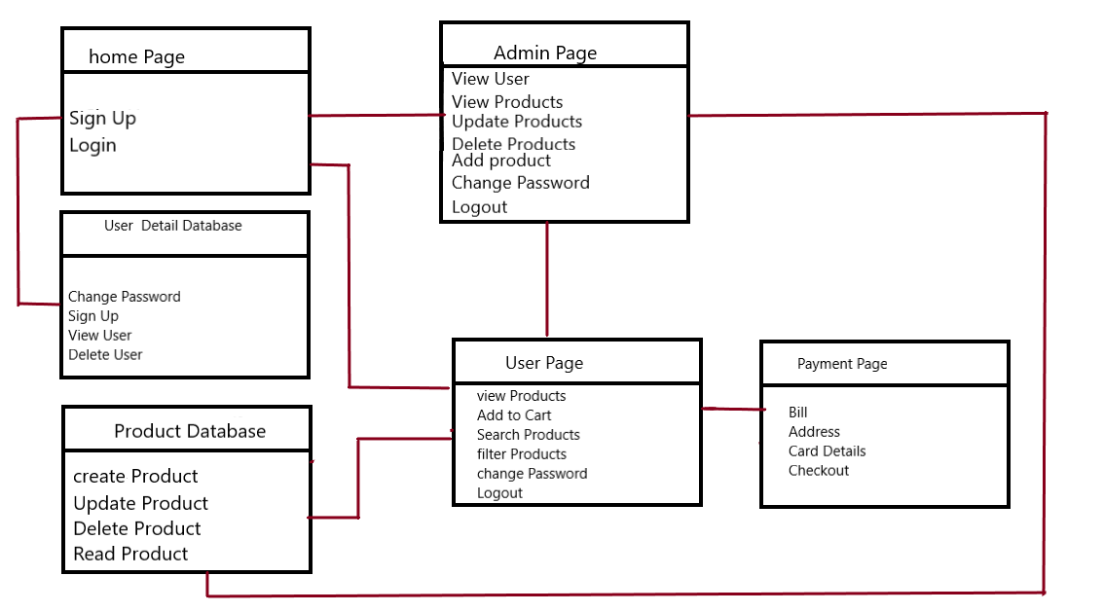
DATA FLOW

Slide 10
PHASES
Backend – bean ,controller, repository
Frontend - Modules
Testing – Selinium and Postman

Slide 11
MODULES OF E-MEDICARE SYSTEM
Login Module: Used for managing the login details
Admin Module: Used for managing medicine details and user information
User Module: Used to purchase product.
Medicine Module: Used for managing the Medicine details
Order Module: Used for managing the details of Order
Payment Module: Used for managing the details of Payment

Slide 12
LOGIN MODULE
Login module enables user and admin to sign –in and sign up to the portal.
Here, the toggle option present in the login page will give us choice between who is using the portal (Admin or User).
And respectively the functionalities will be carried over.

Slide 13
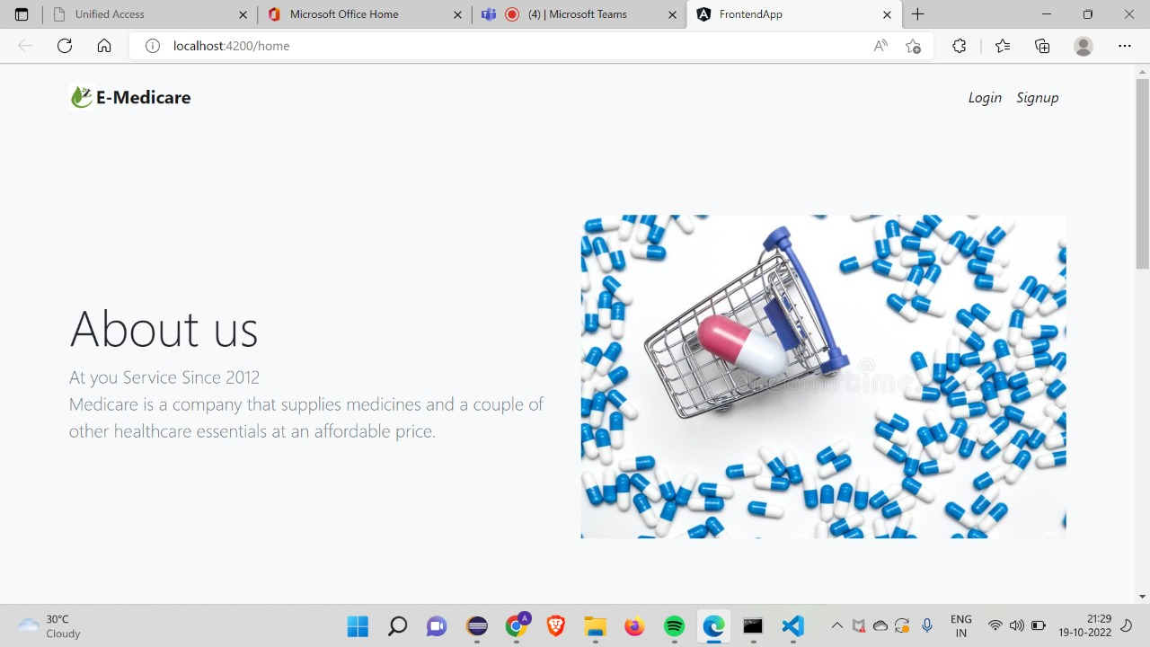
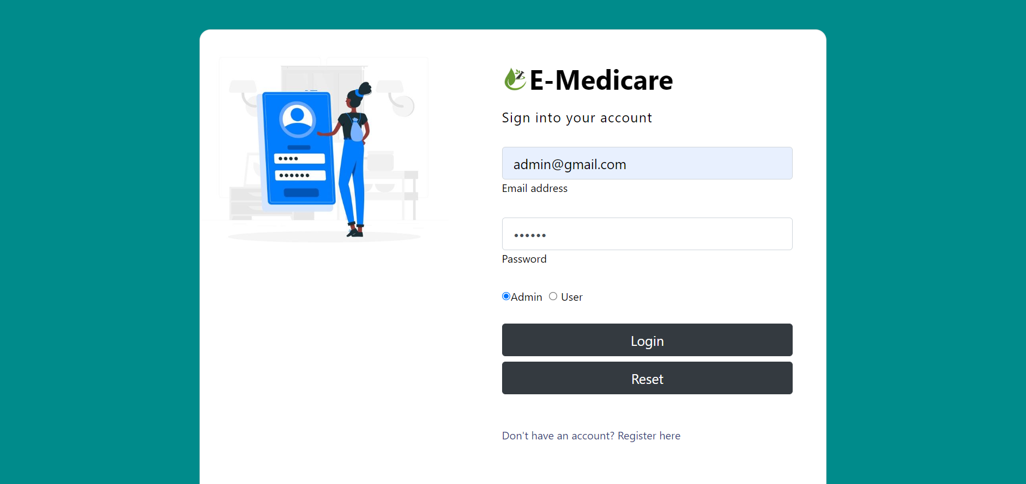

Slide 14
ADMIN MODULE
Signing in as admin will give certain rights to access the portal.
The admin has the authority to manage number of users i.e.., the admin can delete the user.
Managing certain tasks such as adding , updating, deleting the products.

Slide 15
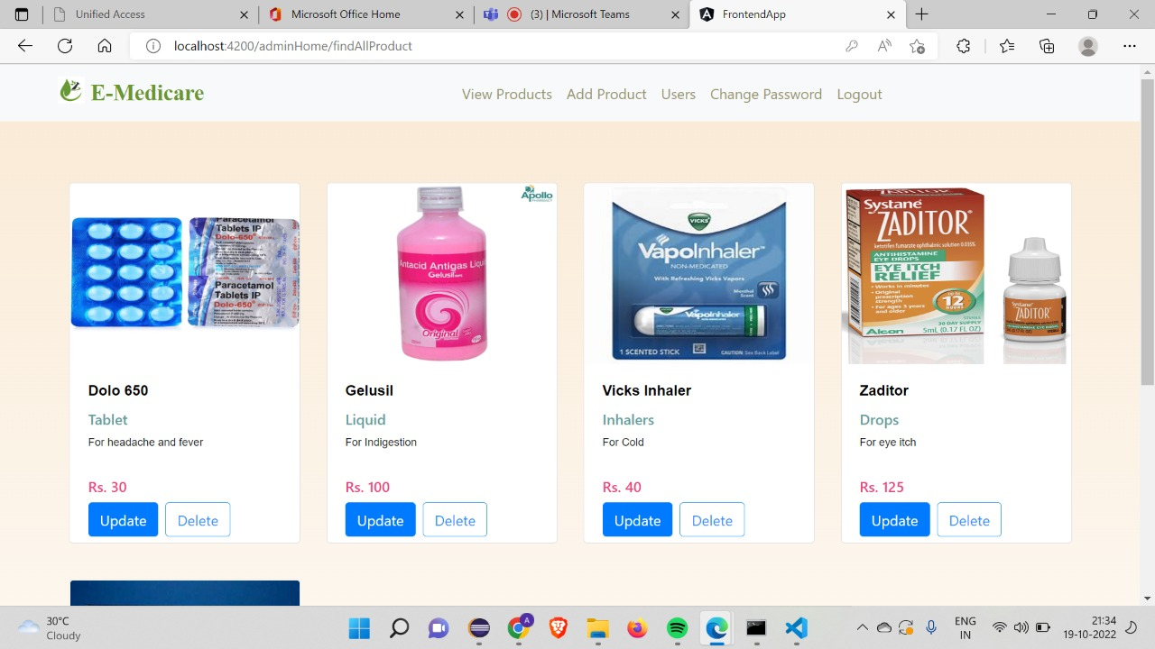
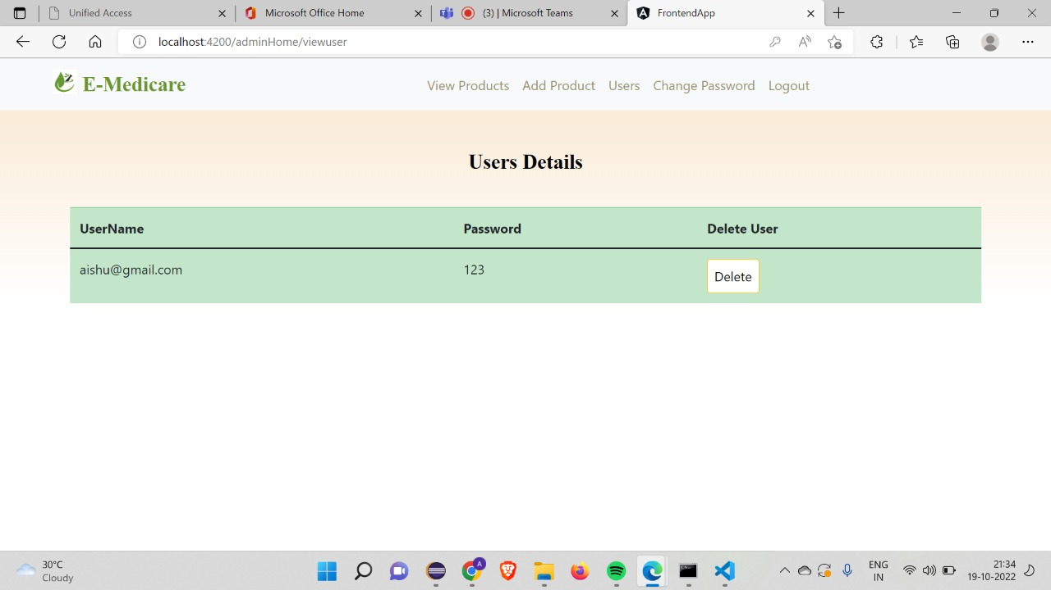

Slide 16
USER MODULE
User is facilitated to purchase product.
The user can add, remove or buy the products.

Slide 17
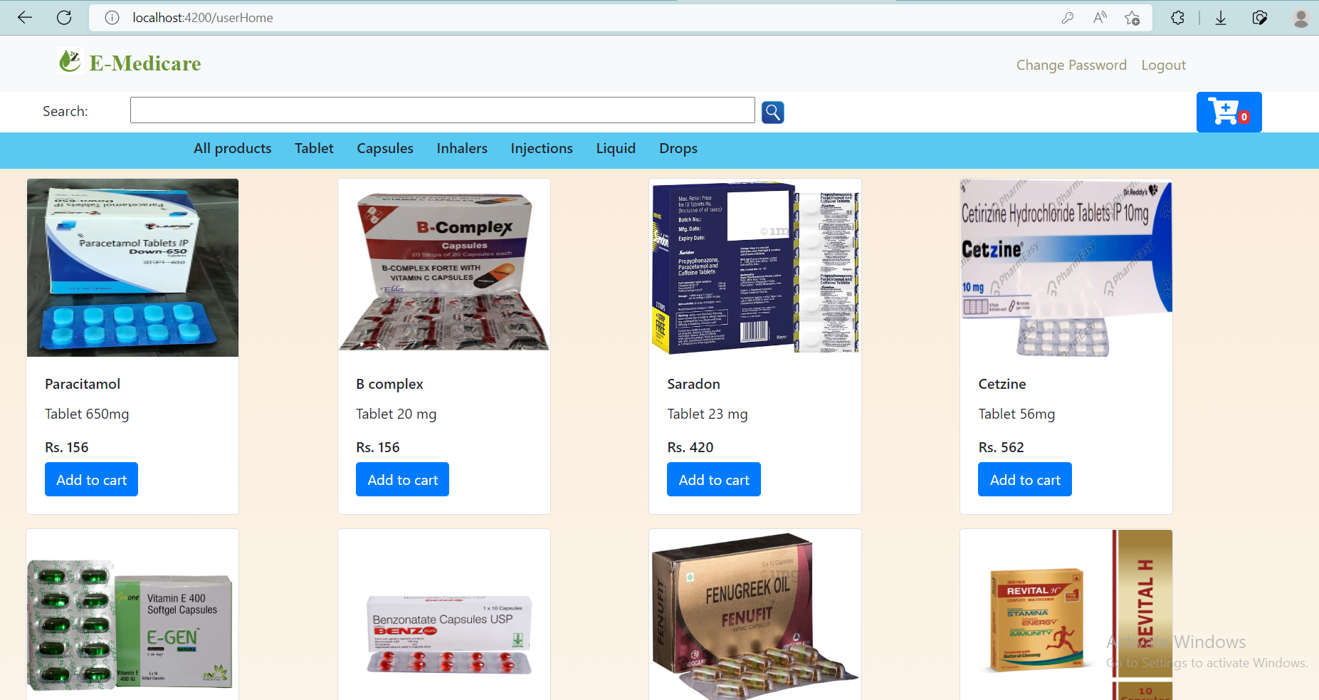

Slide 18
MEDICINE MODULE
In this module, all the products are displayed based on the category like Tablets, Capsules, Injection ,Liquids, Inhaler and Drops.
User can search and sort the products to match their need exactly.
There will be an option enabled for the user to add them to cart.

Slide 19
ORDER MODULE
After the product is being added to cart, checkout option is enabled for user to purchase products.
Checkout will then redirect to payment page.

Slide 20
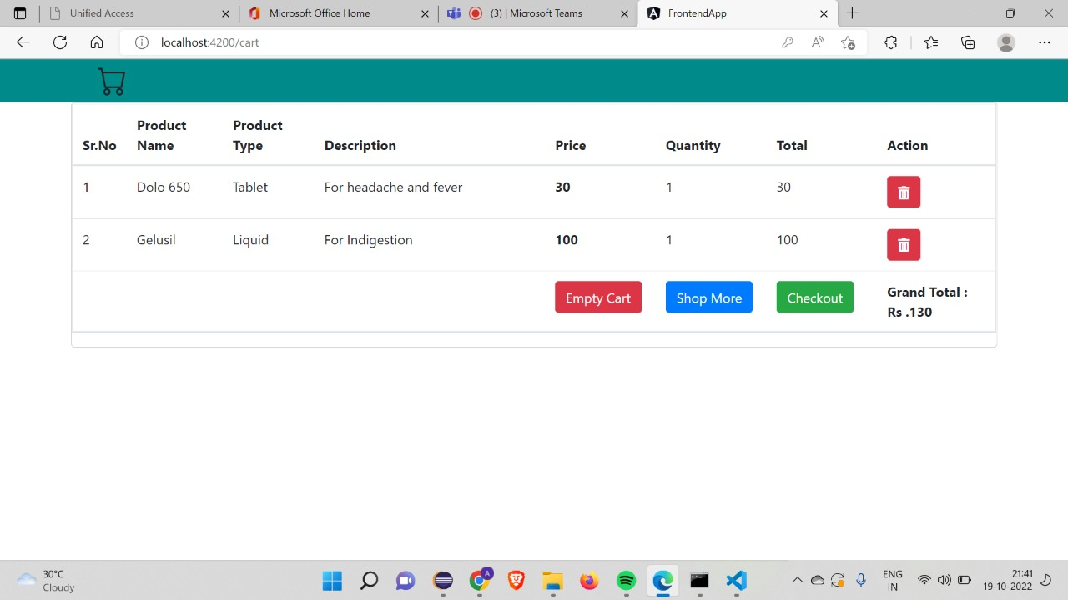

Slide 21
PAYMENT MODULE
User is asked to fill the card and residential details in order to confirm the order.
Then order successful message will pop up to ensure that the order is placed.

Slide 22
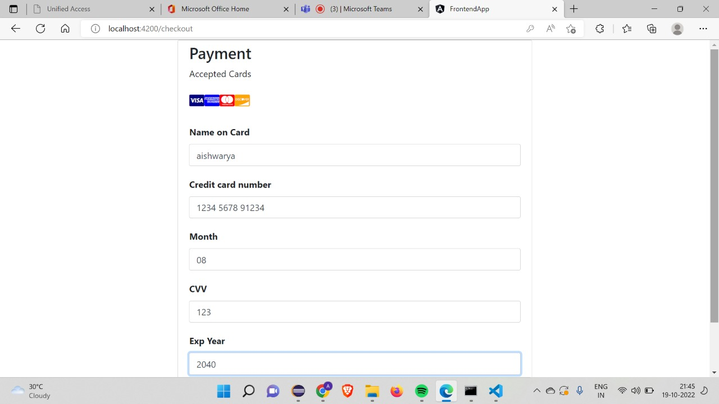
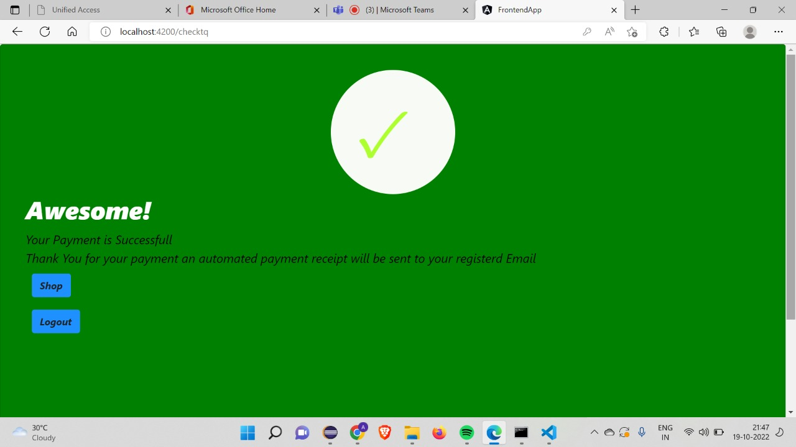

Slide 23
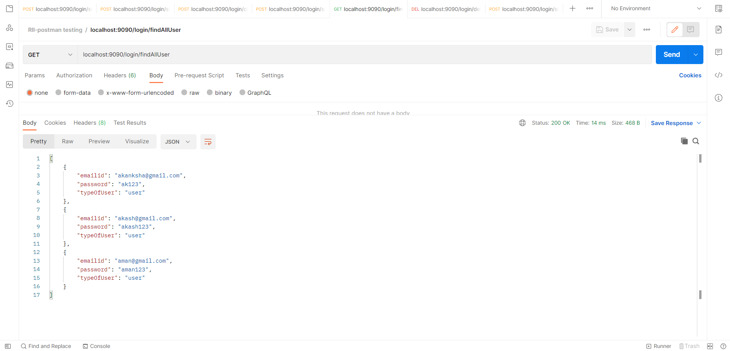
TESTING- POSTMAN

Slide 24
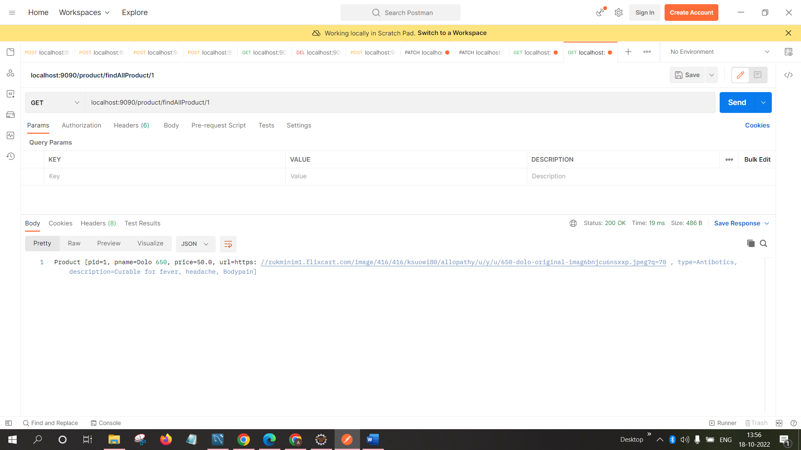

Slide 25
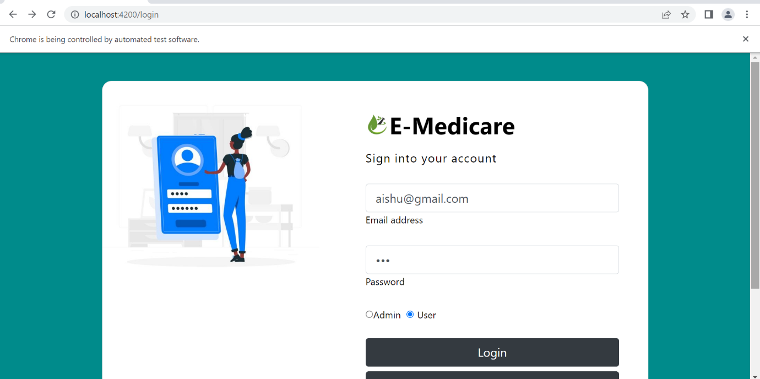
TESTING - SELENIUM

Slide 26
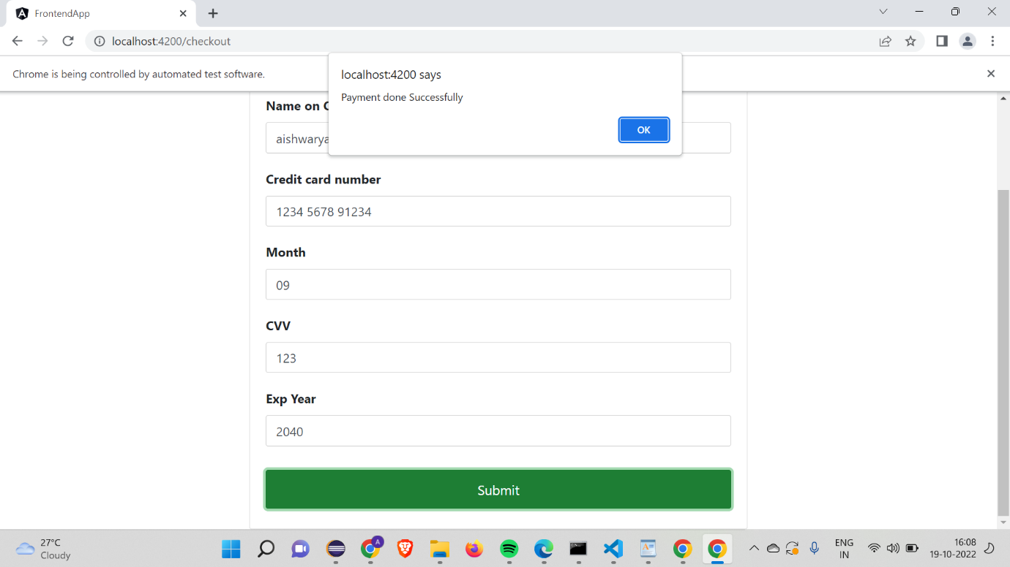

Slide 27
ADVANTAGES
User can view details of the medicines without going anywhere.
User can get their order on their delivery address.
It is convenient for users as this system provides accurate cost and description of the system.
The website is flexible to be used and for e-shopping.
User can view different categories of product of different pharma company at a single place.

Slide 28
CONCLUSION
Our project is only a humble venture to satisfy the needs to manage their project work. Several user-friendly coding has also adopted.
The objective of software planning is to provide a frame work that enables the manger to make reasonable estimates made within a limited time frame at the beginning of the software project and should be updated regularly as the project progresses.
We understand the problem domain and produce a model of the system, which describes operations that can be performed on the system.
We included features and operations in detail, including screen layouts.
We designed user interface and security issues related to system.
Finally, the system is implemented and tested according to test cases.

Slide 29
FUTURE SCOPE
We could implement by taking appointments with doctors and by providing a options to connect with any doctors from all over the world.
Future work could involve more categories which are more detailed and have additional items.
Add different types of shipping options , examples: Regular shipping , Expedited shipping, International shipping.
Allows a user to save the card information for later checkouts .So the scope for eCommerce looks to be ever-increasing and growing with its trend increasing already.

Slide 30
REFERENCES
W3Schools https://www.w3schools.com/
Bootstrap https://getbootstrap.com/
Angular https://material.angular.io/

Slide 31
Akanksha Mishra
Backend- add product,integration
Frontend-add product, searching, sorting,routing.
Testing-postman (add product)

Slide 32
Anubhav Kadam
Backend- Delete User
Frontend-overall UI after completion.
Testing-postman (delete user)

Slide 33
Akanksha Singh
Backend- view user,login module
Frontend- admin module(view user),change password.
Testing-postman (view user)

Slide 34
Adarsh M L
Backend- Update Product
Frontend-Update Product, admin UI.
Testing-postman (update product)

Slide 35
Aravind Chidambaram Pillai
Backend- Add User
Frontend-Sign Up
Testing-postman (add user)

Slide 36
Akash Selvam
Backend- delete product
Frontend-Add To Cart
Testing-postman (delete product),selenium Testing.

Slide 37
Aman Kumar
Backend- Update User
Frontend-Login Module, change Password(user).
Testing-postman (Update User)

Slide 38
Aishwarya Rajagopal
Backend- view product(admin)
Frontend-Add To Cart
Testing-postman (view product),selenium Testing

Slide 39
Ankit Bansal
Backend- View Single User
Frontend-Payment Gateway.
Testing-postman (View Single User)

Slide 40
Aishwarya Sivakumar Manickam
Backend- view product(user)
Frontend-Add To Cart
Testing-postman (view product),selenium Testing

Slide 41
THANK YOU

